Slide 1
StockSense-RAG (News Impact on Stocks)
End-to-End RAG Project by Sachin Kumar
GitHub: https://github.com/devsachink22/StockSense-RAG

Slide 2
Problem Statement (StockSense)
Stock markets react to news + sentiment, not just numerical data.
Traditional models (Regression, Classification, technical indicators) ignore unstructured text.
Market movements often occur due to real-time events not captured in price chart.
Need a system that can predict and explain stock behavior using news context.

Slide 3
Project Objective (StockSense)
Develop an intelligent system that:
  Retrieves relevant financial news
  Embeds & indexes text using ChromaDB
  Predicts next-day stock movement using ML (Random Forest)
  Uses RAG (Retrieval-Augmented Generation) for explanation
Deliver interpretable insights combining data-driven prediction + news-driven reasoning.

Slide 4
Methodology
Quantitative Modeling
  OHLCV data → engineered features (returns, moving averages, momentum)
  Random Forest for directional
Textual Modeling
  News → embeddings using SentenceTransformers
  Stored in ChromaDB for semantic
RAG Integration
  Retrieved articles + user query → LLM explanation

Slide 5
Retrieval-Augmented Generation (RAG)
A hybrid AI framework that combines information retrieval with large-language-model (LLM) reasoning to produce accurate, context-aware, and grounded responses.
  User Query → Embedding
  Retrieve Relevant Documents
  Augment LLM Prompt
  Generate Grounded Answer

Slide 6
Random Forest Classification
Random Forest Classification is an ensembled machine learning algorithm that combines multiple decision trees to make accurate and stable prediction.
Why Random?
Random Sampling of Features (max_features, min_features)
Random Sampling of Data (Bootstrap)
Why Forest?
Because it trains many trees, not just one.

Slide 7
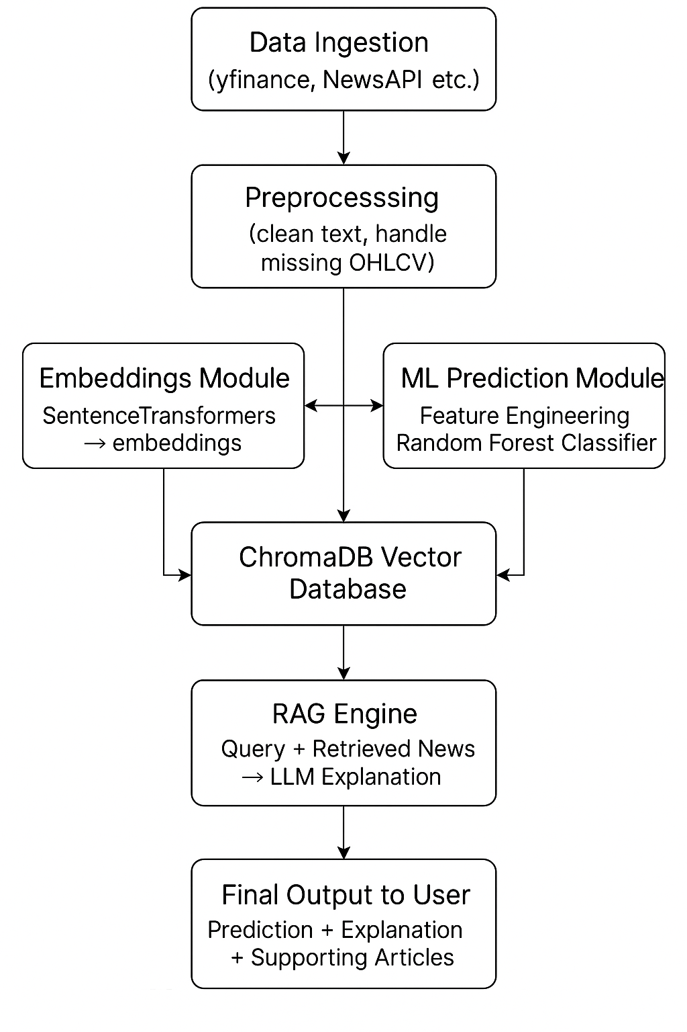
Full System Architecture

Slide 8
Strengths
High interpretability (news-backed reasoning)
Modular architecture
Practical for finance research / decision support

Slide 9
Limitations
News dependency
No deep sentiment scoring yet
Prediction accuracy varies by ticker

Slide 10
Results
RF classifier shows reasonable performance on next-day movement prediction.
RAG retrieves highly relevant news using similarity search.
LLM explanations are significantly more interpretable than raw ML outputs.
Combined system improves contextual credibility of predictions.

Slide 11
Conclusion
StockSense-RAG successfully unifies ML forecasting + RAG explanation.
Enhances transparency compared to pure ML models.

Slide 12
Future Enhancements
Add sentiment quantification
Use transformer-based time-series prediction
Reinforcement learning for multi-step forecasting

Slide 13
Thank You https://www.linkedin.com/in/devsachink22/

